Slide 1
Medicard
SUDESHNA V G
192CT152

Slide 2
Abstract
There is a need for proper database management in all fields and medical field it is extremely important because it deals with the life of people. • Medicard is a device which is used to store and access the medical data in the cloud database. • All the medical database are stored in the cloud and it is accessed under 3 modes of operations. • This is beneficial in the identification of a fast spread disease in short period of time.

Slide 3
Existing Solution to the Problem Addressed
They found methods to produce digitalized medical scanning reports for easy diagnosis. • They use RFID card for storing medical copies in order to make patients know about their reports, problems and having a proper maintenance of medical reports. • They use biometric for authentication.It is most widely using technique in offices,college ,and aadhar

Slide 4
Project Work Plan
In most cases, information is only restricted to medical authorities such as chairman, doctor.This may lead to malpractices, illegal medical practices. • Introducing MEDICARDS will never give a place for happening of all these activities. • It ensures us a safe and secure way of maintaining medical data.

Slide 5
Effective utilization of the Modern Tool & Cloud
The idea proposed here is, using cloud to store and access medical reports • Using fingerprint sensor for login and for authentication of patients. • RFID card is directly connected to cloud and through this we can access medical database.
By using the pharmaceutical database,we will know about fast spreading disease and we can take prevention methods and aware people about that disease. • All the prescription will be send to patient through an APP.

Slide 6
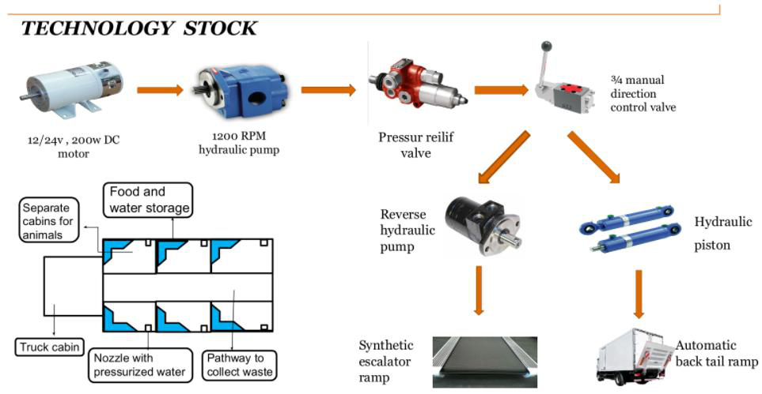
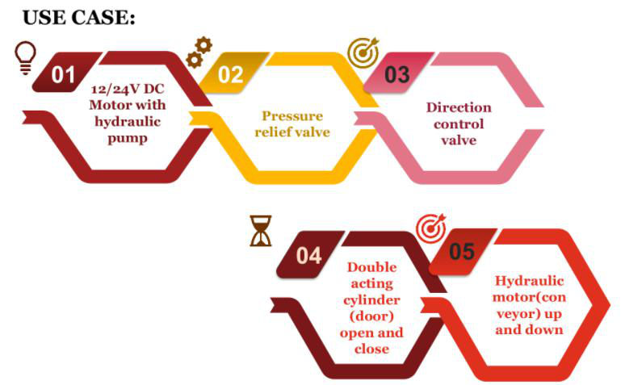
Technology stack & use case

Slide 7
Prototype & Sample Output
Proper diagnosis and establishing a standardized in medical databases can be achieved. • It should be monitored by Central Drug Standard control organization, CCIM( Central Council of Indian Medicine), Indian Medical Association, Medical council of India. • By implementing this so medical crime rate can be reduced, proper database management is achieved, easy identification of fast spread disease can be noted. • Network is an dependent factor.

